Slide 1
Predicting Students' End-of-Term Performances
A Machine Learning Approach
Team Members:
1. Christopher Zavala
2. Sam Ulloa
3. Nima Mahanloo
4. Jerry Do

Slide 2
Introduction
Goal: To utilize machine learning to predict students' end-of-term performances.
Approach: Gathering comprehensive data on demographics, and study habits to build a predictive model.

Slide 3
Choice of Dataset
Dataset Includes:
- Regular activities, transportation, preparation habits, attendance
- Performance metrics such as GPA

Slide 4
Data Description
Variables:
Age
Weekly study hours
Attendance to classes, Preparation for midterms, Note-taking habits
Discussion participation, - Expected cumulative GPA, Output grade

Slide 5
Predictive Model
Features Used as Predictors:
- GPA, Study habits, Class attendance, Note-taking, Unique student ID
Data Preparation:
- Identifying missing values, removing unnecessary columns
- Normalizing data using `StandardScaler` or `MinMaxScaler`
- Scaling numeric features and encoding categorical features

Slide 6
Preliminary Data Exploration
Correlation with GPA:
- Weekly study hours
- Class attendance
- Note-taking habits

Slide 7
Model Training
Models Used:
- Linear Regression
- Random Forest Regression
Training and Testing:
- Splitting data into training and test sets
- Evaluating model performance using Mean Squared Error and R² score

Slide 8
Results Visualization
Visualizations:
- Weekly Study Hours vs. GPA (Actual vs. Predicted using Random Forest)
- Importance of Weekly Study Hours in predicting GPA

Slide 9
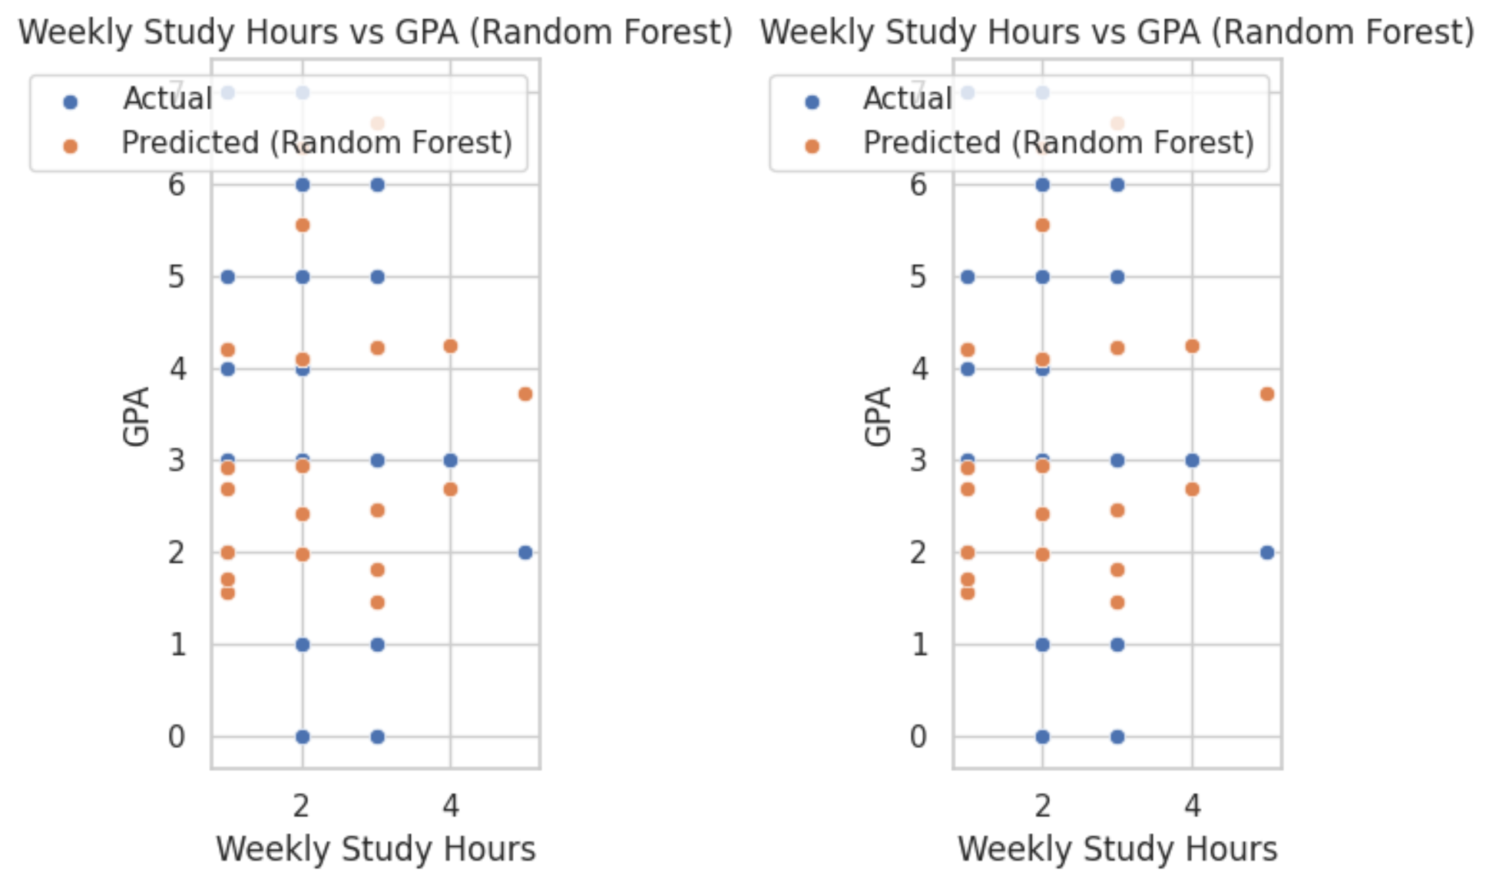
Plot 1

Slide 10
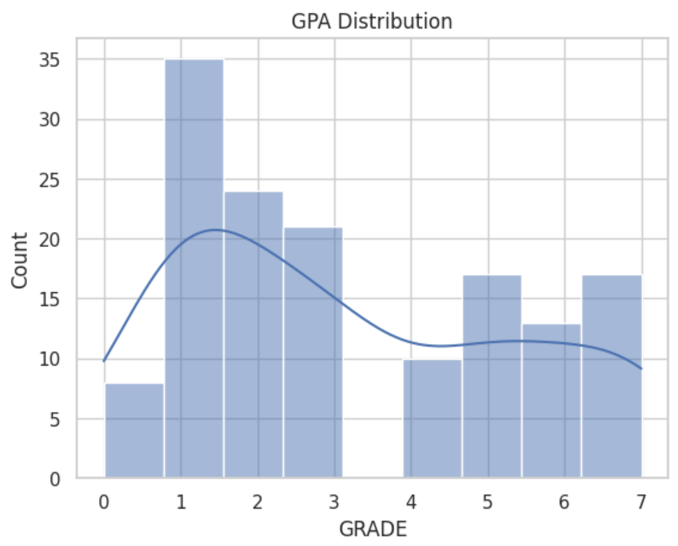
Plot 2

Slide 11
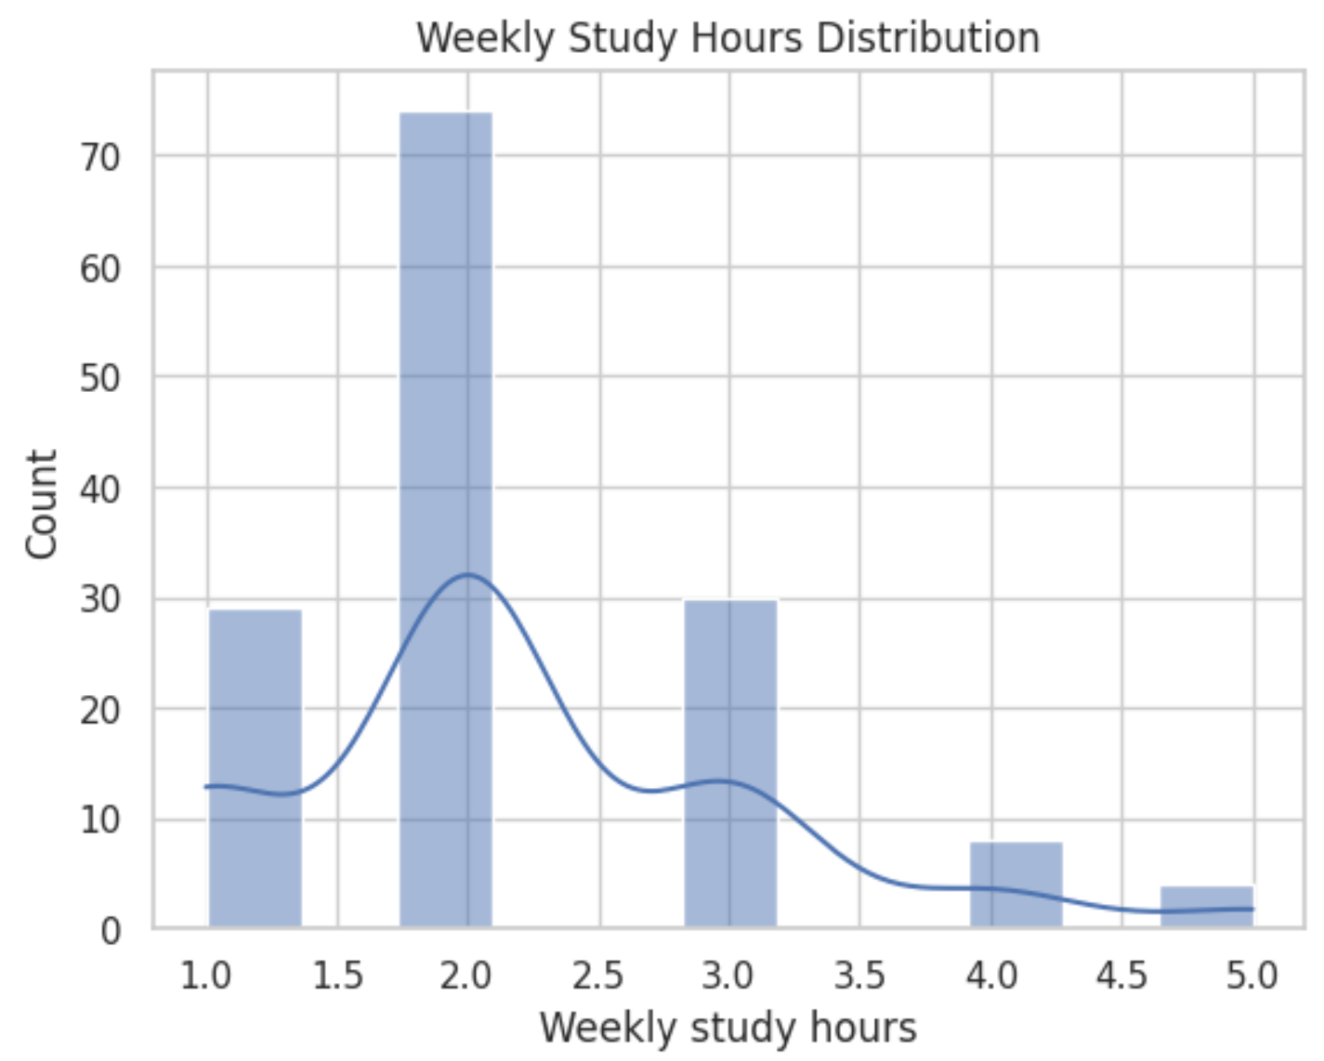
Plot 3

Slide 12
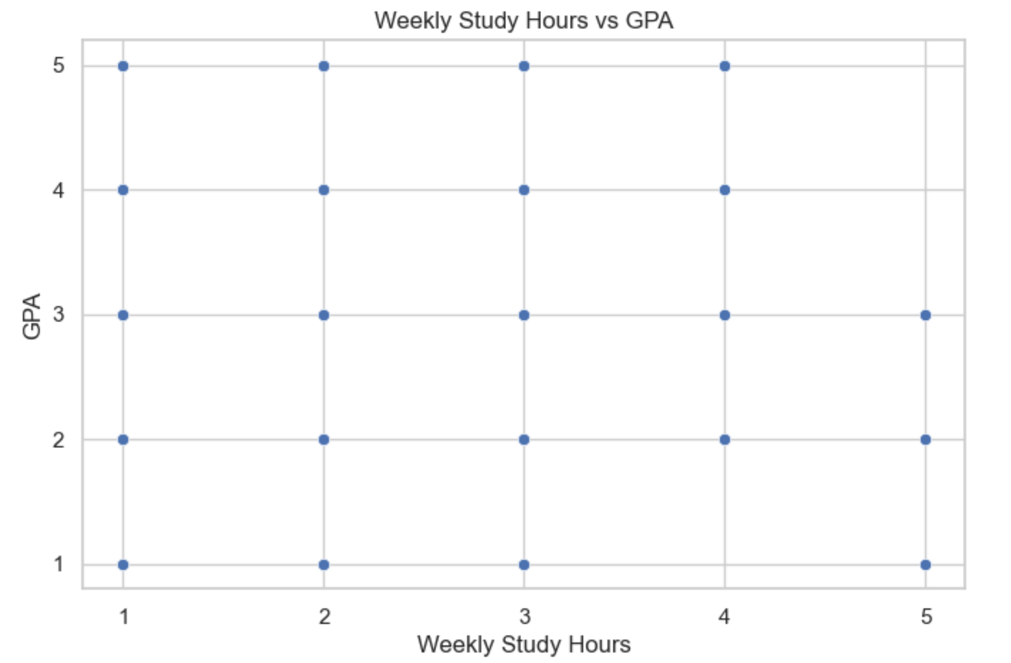
Plot 4

Slide 13
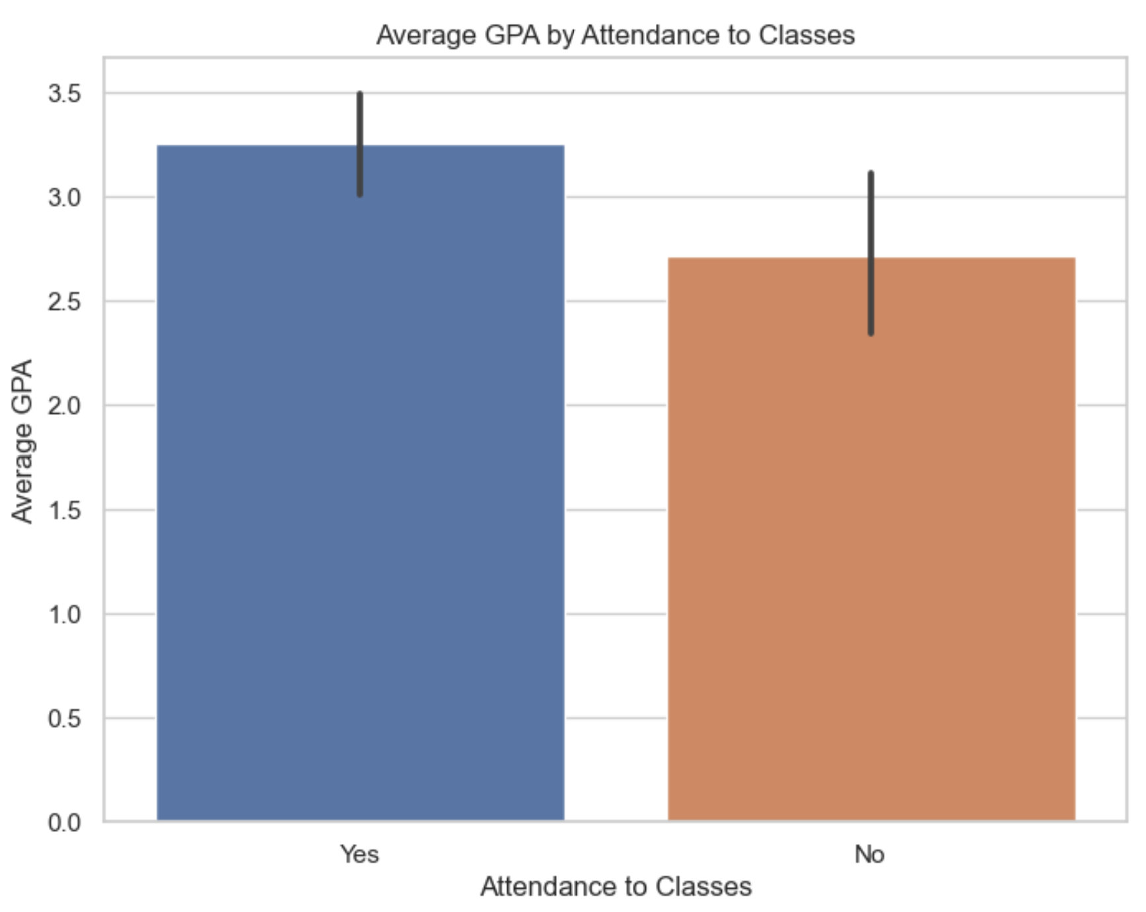
Plot 5

Slide 14
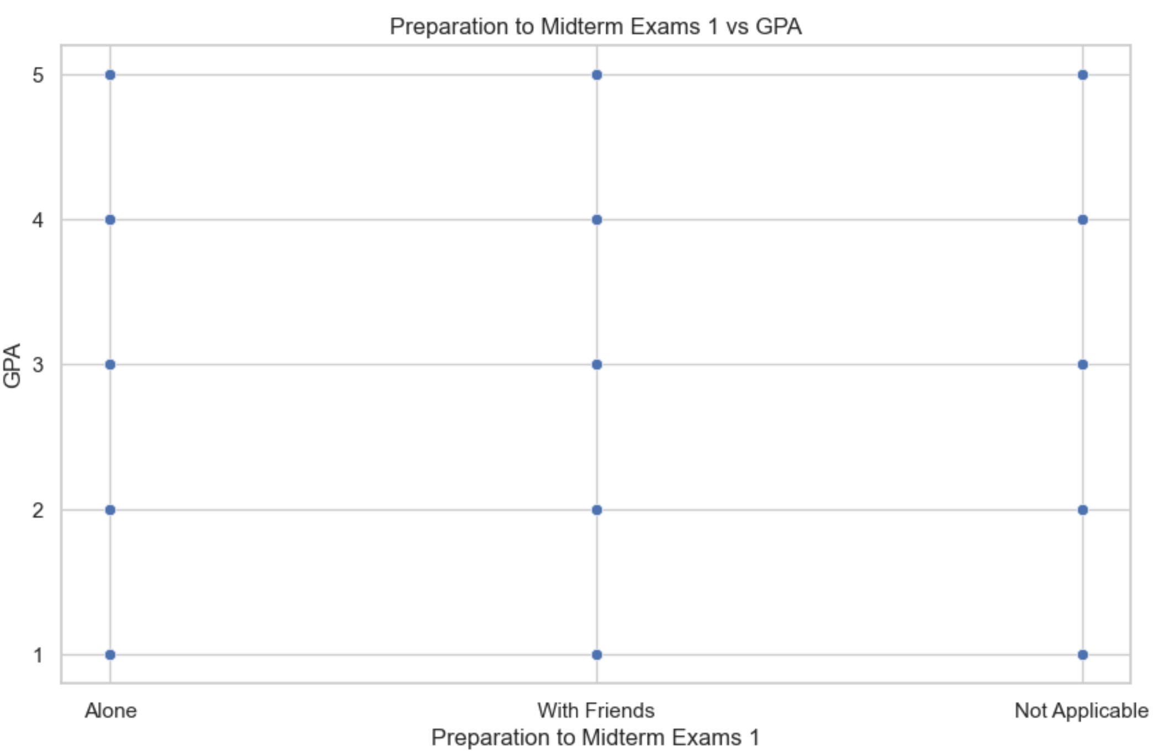
Plot 6

Slide 15
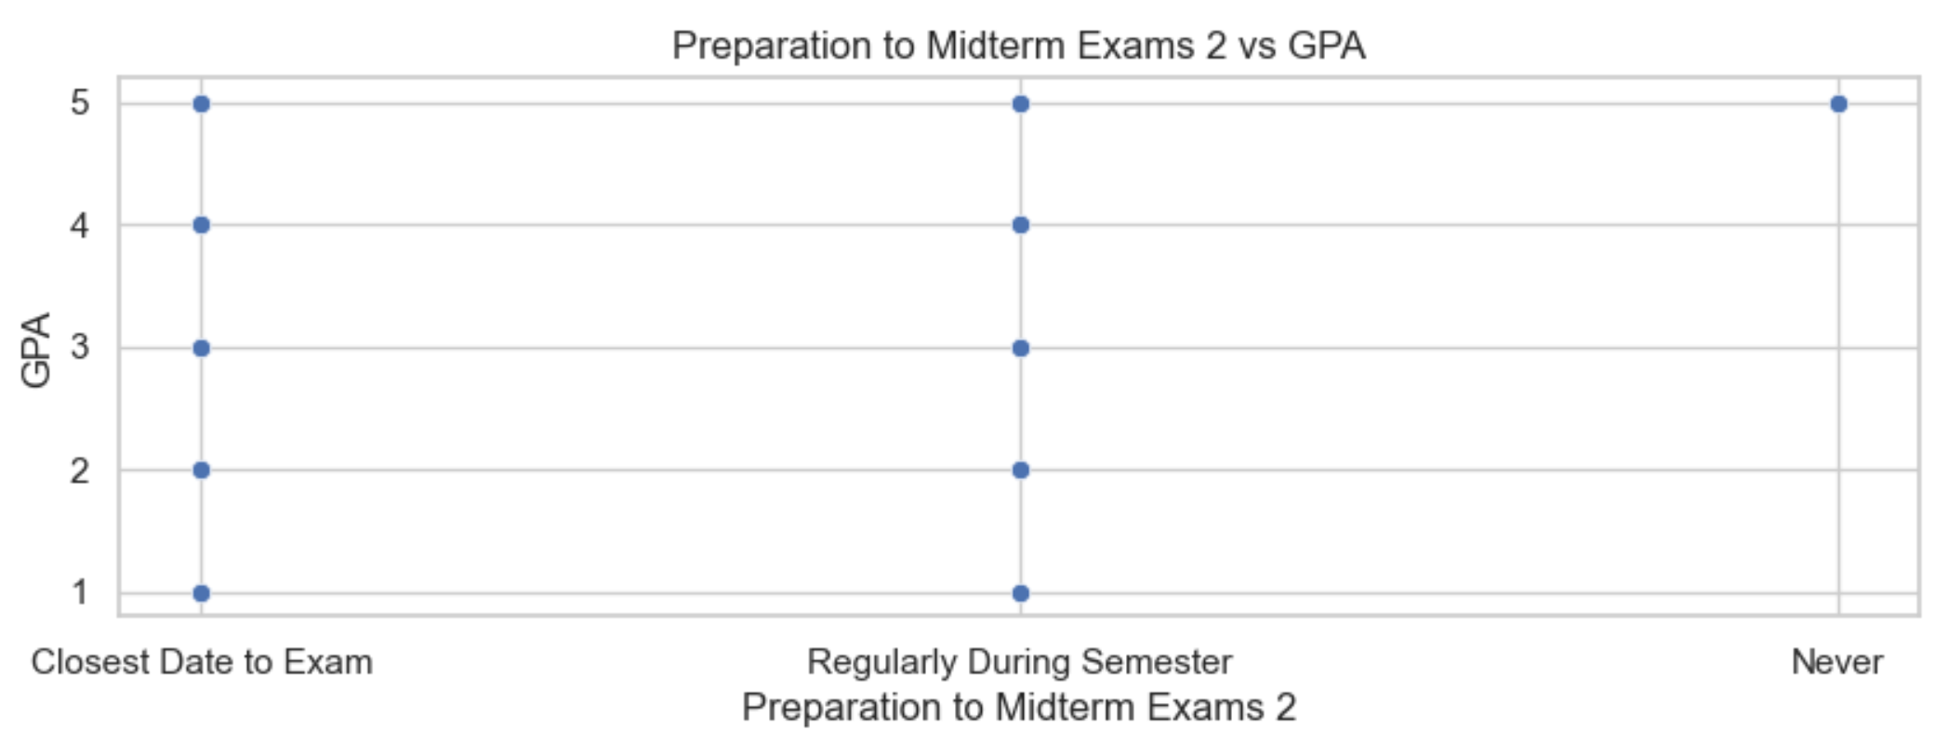
Plot 7

Slide 16
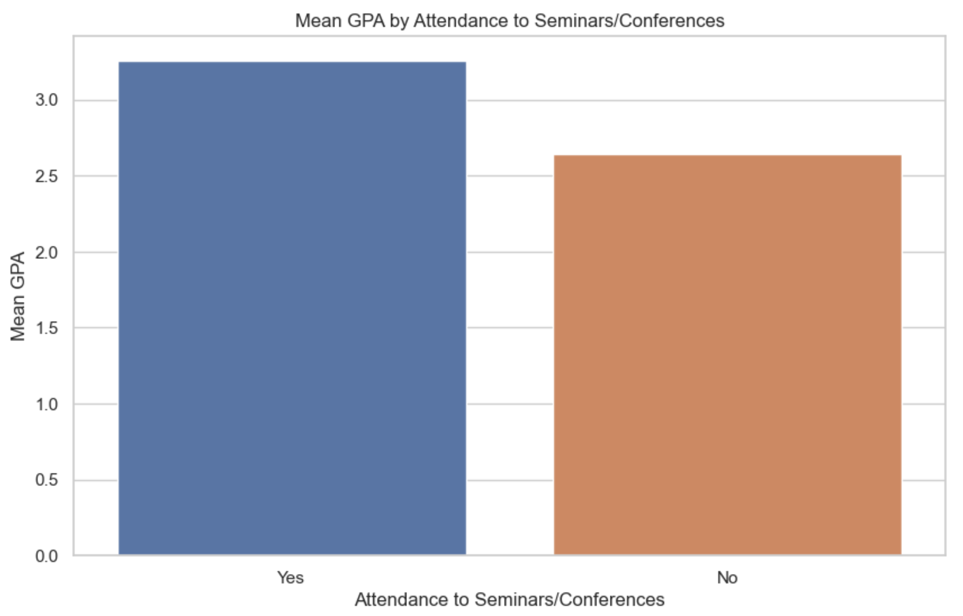
Plot 8

Slide 17
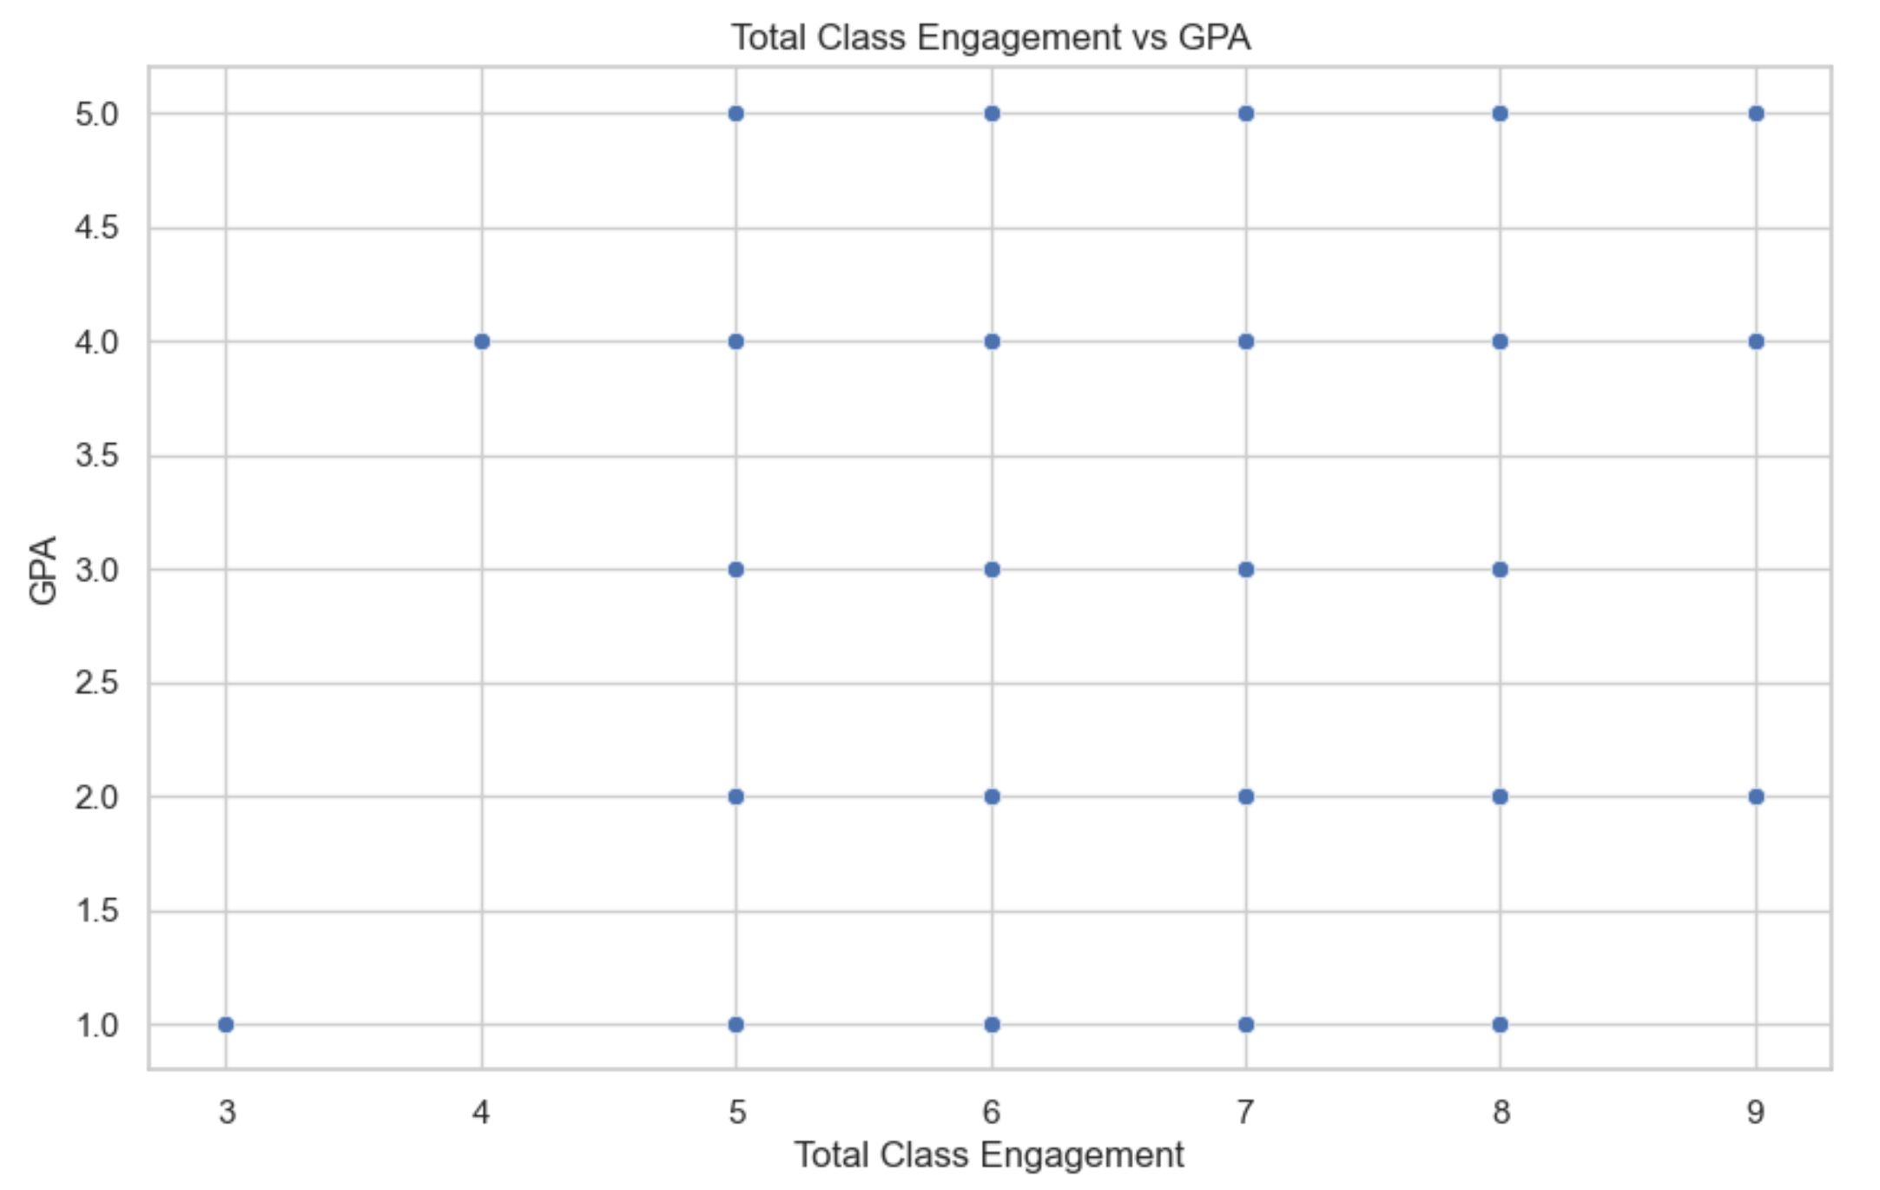
Plot 9

Slide 18
Conclusion
Summary:
- Successful prediction of students' end-of-term performance
- Insights into factors influencing academic success
Future Work:
- Enhancing model accuracy
- Exploring additional variables

